Slide 1
Al-Farabi Kazakh National University
Higher School of Medicine
Department of Fundamental Medicine
Introduction to “Omics” technologies
Lecturer and creator: PhD Pinsky Ilya Vladimirovich
Notes:
Weaver, PART I

Slide 2
LEARNING OUTCOMES
As a result of the lesson you will be able to:
1. Explain, how you understand the term "Omics" technologies?
2. Describe the main Omics technologies (genomics, transcriptomics, proteomics, metabolomics) and their main methods, analyze their connections with each other.
3. Analyze the applications of the main Omics technologies (genomics, transcriptomics, proteomics, metabolomics) in medicine and pharmacy and their perspectives in the Future.

Slide 3
General definition of Omics technologies
The branches of science known informally as omics are various disciplines in biology whose names end in the suffix -omics, such as genomics, proteomics, metabolomics, metagenomics and transcriptomics. Omics aims at the collective characterization and quantification of pools of biological molecules that translate into the structure, function, and dynamics of an organism or organisms [1].

Slide 4
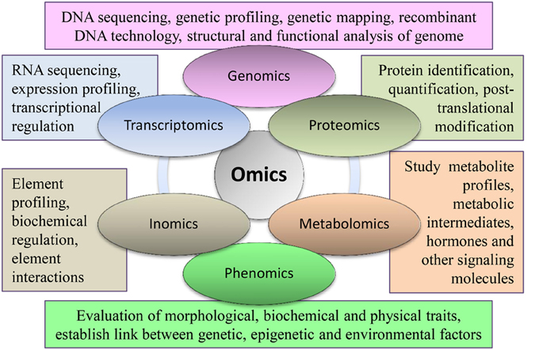
https://www.google.com/url?sa=i&url=https%3A%2F%2Fwww.researchgate.net%2Ffigure%2FImportant-branches-of-omics-with-their-major-components-being-used-in-different_fig3_263055658&psig=AOvVaw1zQ5QAhDIamtp9wjn3wD3u&ust=1643218835800000&source=images&cd=vfe&ved=0CAwQjhxqFwoTCLjh1qq5zfUCFQAAAAAdAAAAABAD

Slide 5
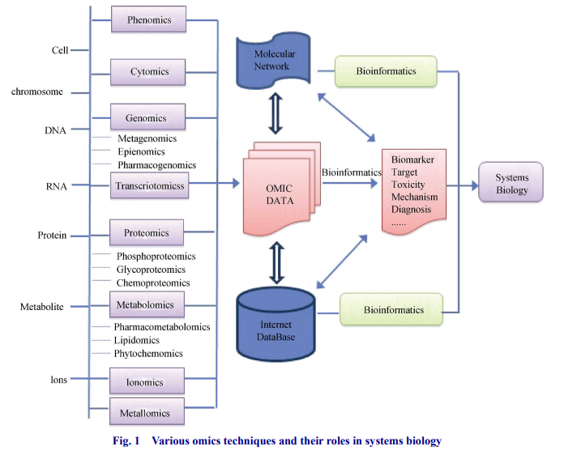
YAN Shi-Kai, LIU Run-Hui, JIN Hui-Zi, LIU Xin-Ru, YE Ji, SHAN Lei, ZHANG Wei-Dong.“Omics” in
pharmaceutical research: overview, applications, challenges, and future perspectives [J]. Chinese Journal of Natural Medicines, 2015, 13 (1): 3-21.

Slide 6
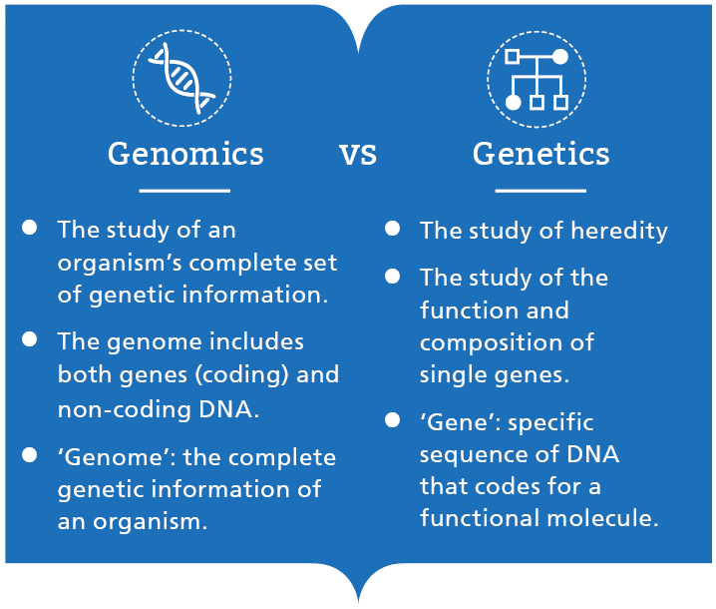
https://www.google.com/url?sa=i&url=https%3A%2F%2Fwww.genomicseducation.hee.nhs.uk%2Feducation%2Fcore-concepts%2Fwhat-is-genomics%2F&psig=AOvVaw1bNaC7FznP7KiWhXZuRAn1&ust=1639319949979000&source=images&cd=vfe&ved=0CAwQjhxqFwoTCLjV2vX82_QCFQAAAAAdAAAAABAT

Slide 7
Main methods of genomics
PCR (polymerase chain reaction)
DNA sequencing
DNA profiling and genotyping (for example, GWAS – genome wide associations studies)
DNA fingerprinting
Hybridization (including DNA microarray)
Computational (bioinformatical) analysis
and etc.

Slide 8
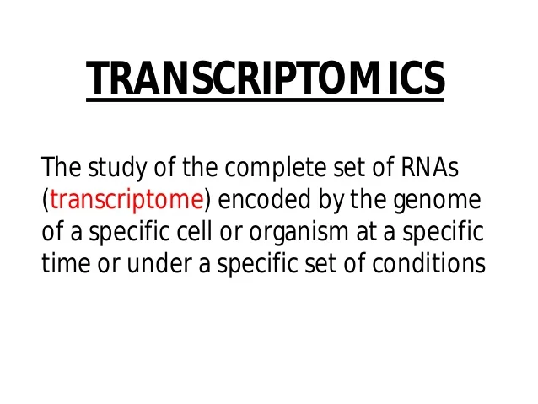
https://www.google.com/url?sa=i&url=https%3A%2F%2Fpt.slideshare.net%2Fsingh_sukh%2Ftranscriptomics-and-metabolomics&psig=AOvVaw2jlculctOki1OIor5u5QBf&ust=1643028502194000&source=images&cd=vfe&ved=0CAsQjRxqFwoTCKiM1bv0x_UCFQAAAAAdAAAAABAO

Slide 9
Main methods of transcriptomics
PCR with reverse transcription
RNA-seq
Gene expession profiling (RNA microarray)
RNA hybridization (for example, Nothern blotting)
Computational (bioinformatical) analysis
and etc.

Slide 10
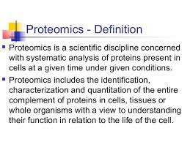
https://www.google.com/url?sa=i&url=https%3A%2F%2Fwww.slideshare.net%2Fappyakshay%2Fproteomics-75139676&psig=AOvVaw28cXwhBaroSF37Tv8-ZuIR&ust=1639320177493000&source=images&cd=vfe&ved=0CAwQjhxqFwoTCJDF6ef92_QCFQAAAAAdAAAAABAJ

Slide 11
Main methods of proteomics
Chromatography
2D-gel electrophoresis
Mass-spectrometry
X-ray crystallography
NMR (nuclear magnetic resonance)
Computational (bioinformatical) analysis
and etc.

Slide 12
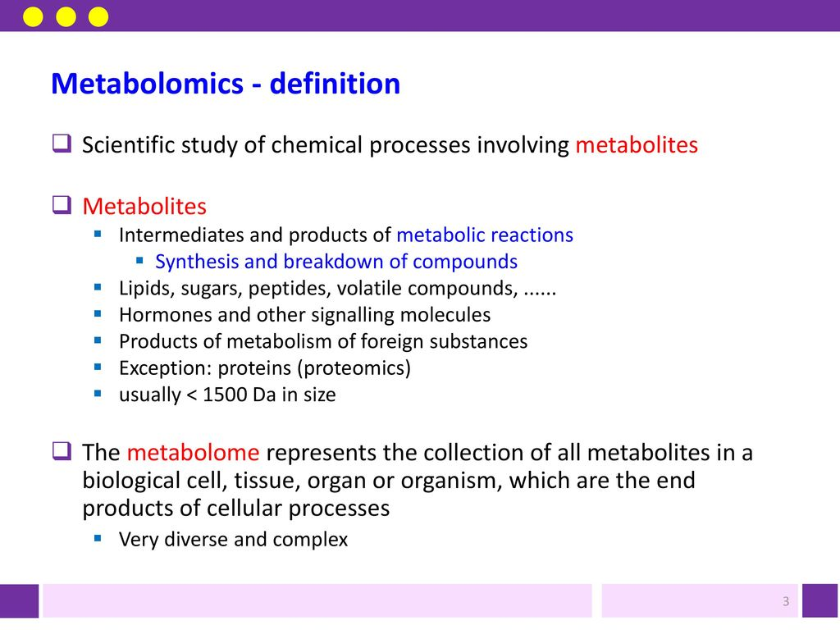
https://www.google.com/url?sa=i&url=https%3A%2F%2Fslideplayer.com%2Fslide%2F13477335%2F&psig=AOvVaw3pvUPVhqY_889qES4x9d9Y&ust=1643028968961000&source=images&cd=vfe&ved=0CAsQjRxqFwoTCLCFkov2x_UCFQAAAAAdAAAAABAP

Slide 13
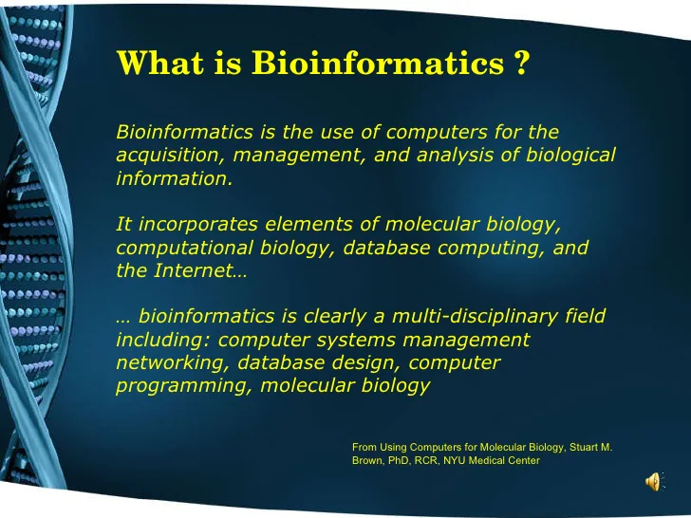
https://www.google.com/url?sa=i&url=https%3A%2F%2Fwww.slideshare.net%2FJTADrexel%2Fbioinformatics-2512758&psig=AOvVaw27r8THpDEy5y6IpNLMTab9&ust=1639320377690000&source=images&cd=vfe&ved=0CAwQjhxqFwoTCPix9rn-2_QCFQAAAAAdAAAAABAX

Slide 14
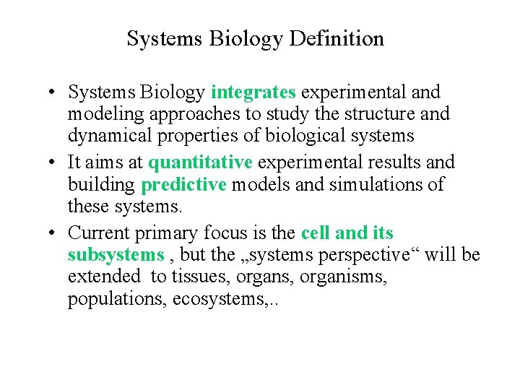
https://www.google.com/url?sa=i&url=https%3A%2F%2Fslidetodoc.com%2Fbiophysics-of-systems-dieter-braun-systems-biophysics-lecture%2F&psig=AOvVaw2RcdiFah8LecP-_An7W9Tp&ust=1643028145705000&source=images&cd=vfe&ved=0CAwQjhxqFwoTCOCyhITzx_UCFQAAAAAdAAAAABAD

Slide 15
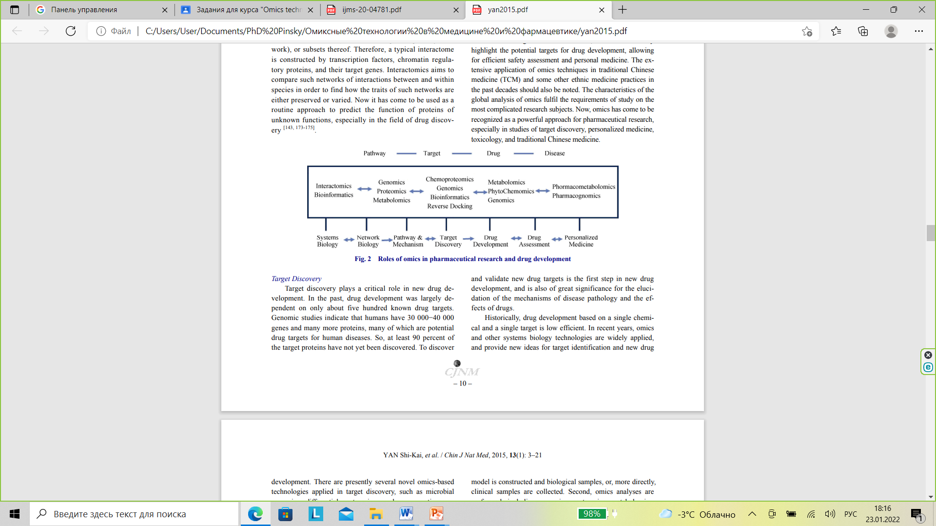
YAN Shi-Kai, LIU Run-Hui, JIN Hui-Zi, LIU Xin-Ru, YE Ji, SHAN Lei, ZHANG Wei-Dong.“Omics” in pharmaceutical research: overview, applications, challenges, and future perspectives [J]. Chinese Journal of Natural Medicines, 2015, 13 (1): 3-21.

Slide 16
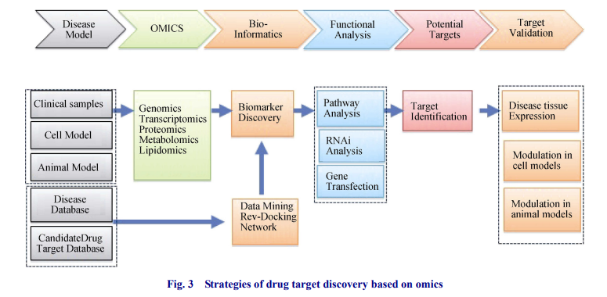
YAN Shi-Kai, LIU Run-Hui, JIN Hui-Zi, LIU Xin-Ru, YE Ji, SHAN Lei, ZHANG Wei-Dong.“Omics” in
pharmaceutical research: overview, applications, challenges, and future perspectives [J]. Chinese Journal of Natural Medicines, 2015, 13 (1): 3-21.

Slide 17
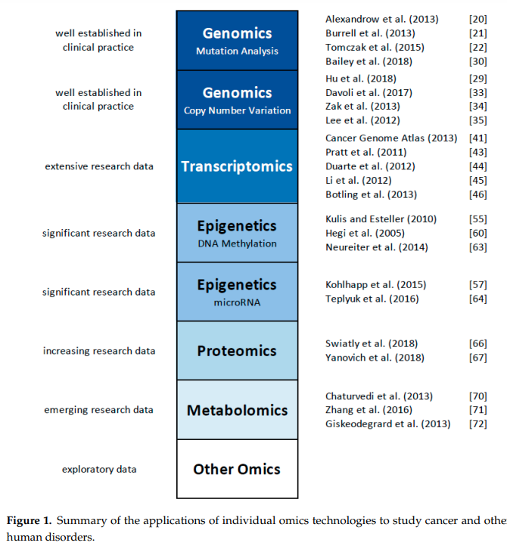
Michael Olivier, Reto Asmis, Gregory A. Hawkins, Timothy D. Howard and Laura A. Cox. The Need for Multi-Omics Biomarker Signatures in Precision Medicine // International Journal of Molecular Sciences. 2019, 20, 4781; doi:10.3390/ijms20194781

Slide 18
References
1. Barh D., Blum K., Madigan M.A. OMICS. Biomedical Perspectives and Applications / 2012 by Taylor & Francis Group, LLC. – 516 p.
2. Holtorf, Hauke; Guitton, Marie-Christine; Reski, Ralf (2002). "Plant functional genomics". Naturwissenschaften. 89 (6): 235–249. Bibcode:2002NW.....89..235H. doi:10.1007/s00114-002-0321-3. PMID 12146788. S2CID 7768096.
3. O'Connell, Mary J.; McNally, Alan; McInerney, James O. (2017-03-28). "Why prokaryotes have pangenomes" (PDF). Nature Microbiology. 2 (4): 17040. doi:10.1038/nmicrobiol.2017.40. ISSN 2058-5276. PMID 28350002. S2CID 19612970.
4. Tashiro, Satoshi; Lanctôt, Christian (2015-03-04). "The International Nucleome Consortium". Nucleus. 6 (2): 89–92. doi:10.1080/19491034.2015.1022703. PMC 4615172. PMID 25738524.
5. Cremer, Thomas; Cremer, Marion; Hübner, Barbara; Strickfaden, Hilmar; Smeets, Daniel; Popken, Jens; Sterr, Michael; Markaki, Yolanda; Rippe, Karsten (2015-10-07). "The 4D nucleome: Evidence for a dynamic nuclear landscape based on co-aligned active and inactive nuclear compartments". FEBS Letters. 589 (20PartA): 2931–2943. doi:10.1016/j.febslet.2015.05.037. ISSN 1873-3468. PMID 26028501. S2CID 10254118.
6. Yan Shi-Kai, Liu Run-Hui, Jin Hui-Zi, Liu Xin-Ru, Ye Ji, Shan Lei, Zhang Wei-Dong.“Omics” in pharmaceutical research: overview, applications, challenges, and future perspectives [J]. Chinese Journal of Natural Medicines, 2015, 13 (1): 3-21.
7. Michael Olivier, Reto Asmis, Gregory A. Hawkins, Timothy D. Howard andLaura A. Cox. The Need for Multi-Omics Biomarker Signatures in Precision Medicine // International Journal of Molecular Sciences. 2019, 20, 4781; doi:10.3390/ijms20194781

